Slide 1
Workshop V
Files and the File System
Part B – File System
Professional Training Academy Linux Series

Slide 2
File Systems
Linux
  reiserfs, ext2, ext3, …
Windows
  ntfs, fat32, vfat, …
Linux can read all
Windows cannot (need to install open source programs to read Linux files)
Linux is very flexible this way!

Slide 3
Layout of Linux File System
Change directory to root
  cd /
List the contents
You will see directories which are similar on all Linux systems
  bin – binary executables
  boot – contains the bootable Linux image
  etc – configuration files
  dev – contains a location for devices
  home – users’ home directories
  media – location where media is mounted
  usr – system users’ files
  var – contains log files, mail queues, print queues, etc.

Slide 4
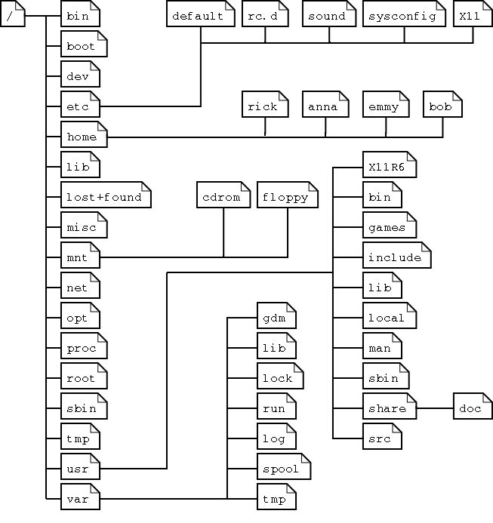
Layout of Linux File System
Source: The Linux Documentation Project. http://www.tldp.org/LDP/intro-linux/html/sect_03_01.html

Slide 5
Layout of Linux File System
Directory | Content
/bin | Common programs, shared by the system, the system administrator and the users.
/boot | The startup files and the kernel, vmlinuz. In some recent distributions also grub data. Grub is the GRand Unified Boot loader and is an attempt to get rid of the many different boot-loaders we know today.
/dev | Contains references to all the CPU peripheral hardware, which are represented as files with special properties.
/etc | Most important system configuration files are in /etc, this directory contains data similar to those in the Control Panel in Windows
/home | Home directories of the common users.
/initrd | (on some distributions) Information for booting. Do not remove!
/lib | Library files, includes files for all kinds of programs needed by the system and the users.
/lost+found | Every partition has a lost+found in its upper directory. Files that were saved during failures are here.
/misc | For miscellaneous purposes.
/mnt | Standard mount point for external file systems, e.g. a CD-ROM or a digital camera.
/net | Standard mount point for entire remote file systems.
/opt | Typically contains extra and third party software.
/proc | A virtual file system containing information about system resources. More information about the meaning of the files in proc is obtained by entering the command man proc in a terminal window. The file proc.txt discusses the virtual file system in detail.
/root | The administrative user's home directory. Mind the difference between /, the root directory and /root, the home directory of the root user.
/sbin | Programs for use by the system and the system administrator.
/tmp | Temporary space for use by the system, cleaned upon reboot, so don't use this for saving any work!
/usr | Programs, libraries, documentation etc. for all user-related programs.
/var | Storage for all variable files and temporary files created by users, such as log files, the mail queue, the print spooler area, space for temporary storage of files downloaded from the Internet, or to keep an image of a CD before burning it.
Source: The Linux Documentation Project. http://www.tldp.org/LDP/intro-linux/html/sect_03_01.html

Slide 6
Everything is a File
Everything that is not a process is treated as a file on Linux
For example, a directory is just a file which lists the contents of the directory
Just like system processes, files have id numbers
You can also view programs, for example, try using less to see the ls command
  less /bin/ls

Slide 7
Recovering Disks
If you have a hard disk which has failed and Windows will not boot from it or allow you to copy your needed files
Try using a live Linux CD to inspect the hard drive
If your disk is recoverable, you can mount the drive from your live CD and copy them to a backup location
It is always worth a try!

Slide 8
Partitions
The previous example of a disk failure is the main reason why we use disk partitions. The damage is minimised to the partition instead of the entire disk
To view the partitions on your computer use the disk space usage command called df.
Note: The -h option may be used to print the sizes in a more human readable format, as follows:
  df -h

Slide 9
Repairing Disks
If your Linux disk is faulty or causing problems, you can use a repair program
For example, the fsck (file system check) program will check and repair a file system
  fsck /dev/hda1
This will try to repair any broken links on hard disk number 1
Or just type fsck on its own to choose from available partitions

Slide 10
Creating Bootable CDs
A good local mirror of Linux distribtions and open source software is available at: ftp.esat.net
The ISOs can be burnt on to CD or DVD and will allow you to boot and install Linux
K3b is a popular CD burner program for Linux

Slide 11
Exercises
Examine your root directory on your system and draw a tree diagram of the most important directories
Find a new program in the system-wide users' binary directory
Examine the disk partitions on your system, how big is your home directory in GB?

